Slide 1

Energy Efficiency:
Overview and Opportunities
Go Green Illinois Meeting
January 2021

Slide 2


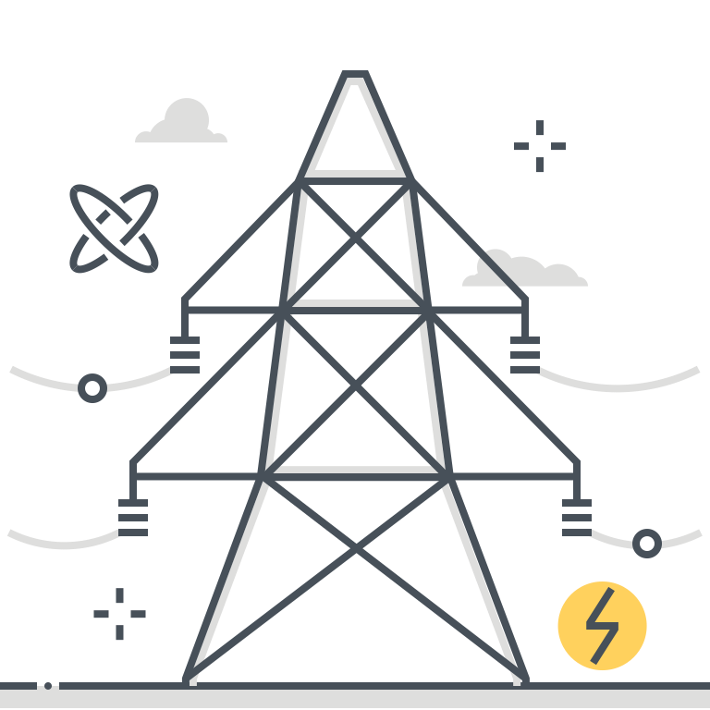

Midwest Energy Efficiency Alliance
MEEA is a collaborative network, promoting energy efficiency to
optimize energy generation, reduce consumption, create jobs
and decrease carbon emissions in all Midwest communities.
MEEA is a non-profit membership organization with 150+ members, including:
Energy service
companies & contractors
State & local
governments
Electric &
gas utilities
Academic &
Research institutions

Slide 3
Benefits of Energy Efficiency
Supports energy-related priorities
Right-sizes grid and energy demand
Environmental protection and health: avoided/retired generation; essential decarbonization pathway; improved indoor and outdoor air quality; improved quality of life
Equity: reduced energy burden; reduced bill debt and arrearages; improved housing quality; high-quality job opportunities
Supports adoption and integration of emerging technologies and renewables
Supports grid modernization
Currently lowest-cost resource to meet demand in the Midwest
Supports non-energy priorities
Economic development: local workforce development; reduced business operating costs; business attraction and retention

Slide 4
Energy Efficiency Policy in Illinois
Energy Efficiency Resource Standards
  Energy savings goals
  Established for electric utilities by IPA Act in 2007; amended in 2009 to include gas
  FEJA and CEJA amends electric provisions in Illinois Power Agency (IPA) Act
2010: IPA amended; Gas savings goals established
2016: FEJA; New electricity savings requirements
2021: CEJA; Extended savings goals & decarbonization; Expanded programs
2007: Illinois Power Agency (IPA) Act
Notes:
Midwest Overview:
Look at which states are undertraining energy planning
Processes take different forms, objectives take different forms
Discuss why Midwest states need to develop new state energy plans
Priorities; federal funding
Stakeholder engagement
Transforming energy landscape: new technologies, decarbonization, resilience threats
What can we learn from planning processes that are currently underway?

Slide 5
Changes to EE Programs Following FEJA (Post-2016)
FEJA (and CEJA) only pertains to electric utility energy efficiency
FEJA was a catalyst for low- and moderate-income programs
  Prior to FEJA, DCEO ran low-income energy efficiency programs (as well as public facilities and public housing programs)
  After FEJA, utilities began running low-income programs
  Utilities substantially expanded multifamily housing offerings
Change in structure of electric utility energy savings goals
  Formerly annual savings goals, now a cumulative savings goal with annual savings targets (which accrue each year)

Slide 6
CEJA Overview
Statewide power sector decarbonization
Increases equitable workforce development efforts to strengthen BIPOC and environmental justice communities through pathways to the clean energy industry
Energy Efficiency-Specific
Changes to electric energy efficiency standard, allows electrification
Replaces large customer exemption with new framework
Increases support for low-income programming/coordination and the health and safety/deferral issue
Requires that the state develop a statewide stretch code for munis to adopt

Slide 7
New Utility Programs (2022-2025)
Changes:
  Increased budgets across sectors
  Focus on whole-home projects
  Electrification measures
See the plans (note: following passage of CEJA, utilities are re-filing plans according to new policy)
  Ameren
  ComEd
  Nicor Gas
  Peoples Gas/North Shore Gas

Slide 8
Low-Income Programs
Minimum annual spending levels increased
  Ameren - $13 million (up from $8.35 million)
  ComEd - $40 million (up from $25 million)
80% of spending goes to whole building
Dedicated funds for addressing health and safety issues
  Structural or indoor hazards that must precede EE work
  15% of LI budget dedicated
Electrification
  Electric utilities can claim limited savings for gas conversion energy savings
  Annually, 25% of these savings must come from low-income households
Statewide Low-Income EE Accountability Committee
  North and Central/South Subcommittees administered by Illinois Commerce Commission

Slide 9
New and Existing Buildings
Buildings are 40% of the country’s energy consumption!
Policies
  Existing buildings: benchmarking ordinances, building performance standards
  New construction: building energy codes
  Major pushback from developers – cost of construction and compliance
CEJA will create a residential and commercial stretch code for voluntary adoption by jurisdictions starting 2024

Slide 10
Energy Efficiency Opportunities & Calls to Action
Community Engagement
Raise awareness of energy efficiency in your community – utility energy efficiency programs exist
Raise awareness of commitments in the Metropolitan Mayor’s Caucus Climate Action Plan
Talk about energy efficiency and solar together - reduce energy consumption to lower cost and improve reliability of solar, DERs and clean energy technologies
Speak to elected officials about energy efficiency benefits, jobs and projects
Funding Advocacy
Advocate for funds to supplement existing programs and cover whole-home projects
Advocate for funds to address health & safety/deferral issues
Talk to us!
MEEA have resources to support your efforts – 101 messaging and facts, drafting ordinance language, feasibility analysis

Slide 11
Energy Efficiency Opportunities & Calls to Action
Advancing Policies: Codes and Performance Standards
Jurisdictions can adopt CEJA stretch code targets now for commercial buildings
Opportunity to advance EV charging, solar-ready, storage-ready, demand response-ready, electrification through the electricity code – separate from the building energy code
Support workforce development in your community
Schools and colleges can support and supplement new and existing workforce development
Represent your community in utility EE discussions
Engage in the Illinois Stakeholder Advisory Group and/or the Income Qualified Accountability Committees

Slide 12
Thank you!
Samarth Medakkar, Policy Associate
Midwest Energy Efficiency Alliance
smedakkar@mwalliance.org

Slide 13
Resources
MEEA Resources
EE Policy Basics
Topic Fact Sheets
Energy Efficiency Messaging
Energy Efficiency: Fact vs. Fiction
MEEA Policy Insider (State-level Tracking and Opportunities)

Slide 14
Energy Efficiency Programs Before FEJA
Single-Family Homes
Energy assessments, direct install kits, appliance recycling
Commercial Buildings
Custom projects
Air sealing and insulation
Industrial
Run by DCEO
Energy assessments, appliance recycling
Income-Qualified & Public Housing/Facilities
Energy assessments
HVAC rebates at retailers and Furnaces
HVAC
Big focus on lighting rebates at retailers
Lighting programs
Limited specific offerings
Energy savings kits
Above-code construction
Above-code construction
Notes:
Slide lists considerations for 5 important, common process steps in state energy planning. Drawn from existing state energy plans, recommendations by NASEO and DOE, and MEEA’s EE expertise.
Baseline metrics:
Understand the cost of levelized cost of EE in your state compared with energy sources (current and outlook);
Understand EE potential in your state by sector;
Understand adoption, market outlook and opportunity for technologies including energy-efficient appliances, batteries, electric vehicles, etc.
Note: Baselining is an iterative process and stakeholder may raise baselining needs throughout the process. Consider potential unforeseen factors or needs, for example geopolitical factors. Lay out the known unknowns.
Public Input:
Solicit engagement and input from all stakeholders in the state;
Focus on under-represented, historically marginalized, and/or highest-need communities;
Engagement with policymakers, agencies, and other government stakeholders (work towards institutional buy-in)
Recommendations: Determining actionable, feasible recommendations and measures
Consider, what is a feasible time-frame for implementation of the plan and its recommendations?
Consider political environment, consensus and feasibility. What measures already have legs (buy-in)? What will require education?
Who are the champions and key actors for implementing each recommendations
Implementation:
Ongoing engagement and working groups with implementors or each strategy
Resources and technical assistance for local governments
Establish buy-in: communicate and promote how the plan is being implemented to new administrators, policymakers and the public at large
What measures are currently in the works?;
Upon implementation, what can benefits and outcomes can stakeholders expect?
Promote the plan upon realizing any benefits
Reporting: A specific reporting process is crucial
How often will the agency/state report progress? How will these be organized? (overall plan or by sector/area?)
Consider progress requirements or reporting for relevant government agencies

Slide 15
Equitable Energy Upgrade Program
Pages 897-905
Allows customers to finance the construction of energy projects through an optional tariff payable directly through the utility bill, modeled after Pay As You Save (PAYS – EEI)
  Emphasis on EE, storage and solar
  Emphasis on environmental justice and low-income households

Slide 16
Public School Carbon Free Assessment Program
Pages 667-671
Assessment program for schools
  Increase efficiency
  Reduce carbon emissions
  Goal of carbon-free schools by 2030
Electric utilities can claim energy savings for programs offered to schools to address assessed opportunities

Slide 17
Workforce Development Provisions
Pages 1-60
Clean Jobs Curriculum
Energy Transition Navigators
IL Climate Works Pre-apprenticeship Program
Clean Energy Contractor Incubator Program
Returning Residents Clean Jobs Training Program
Clean Energy Primes Contractor Accelerator
Jobs and Environmental Justice Grant Program

