Slide 1
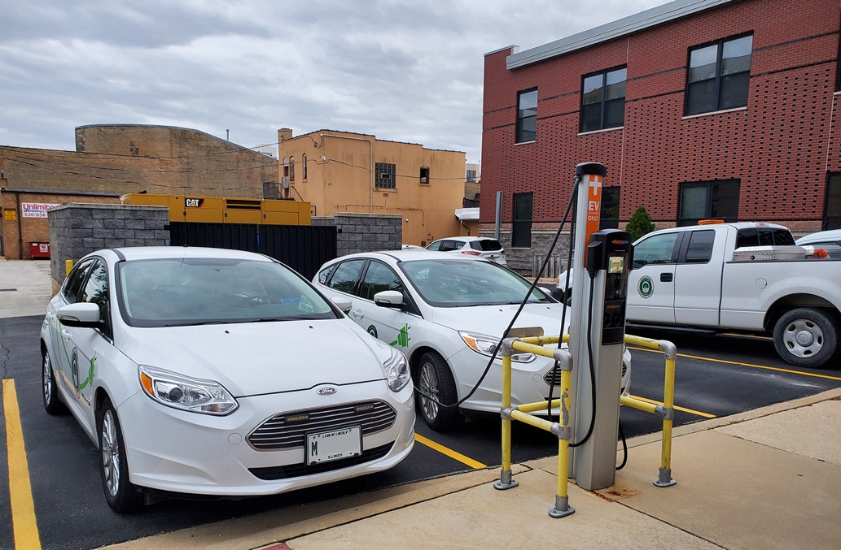


Becoming EV Ready

Slide 2
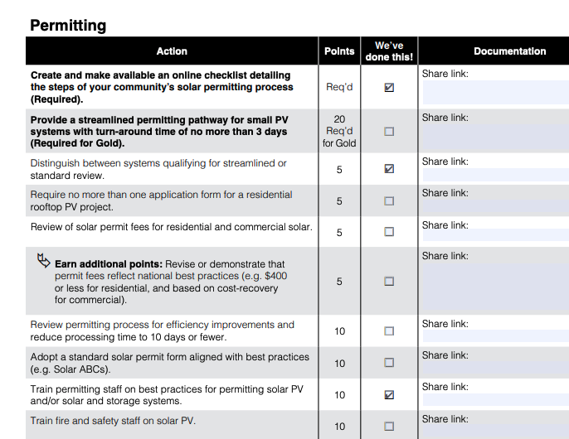
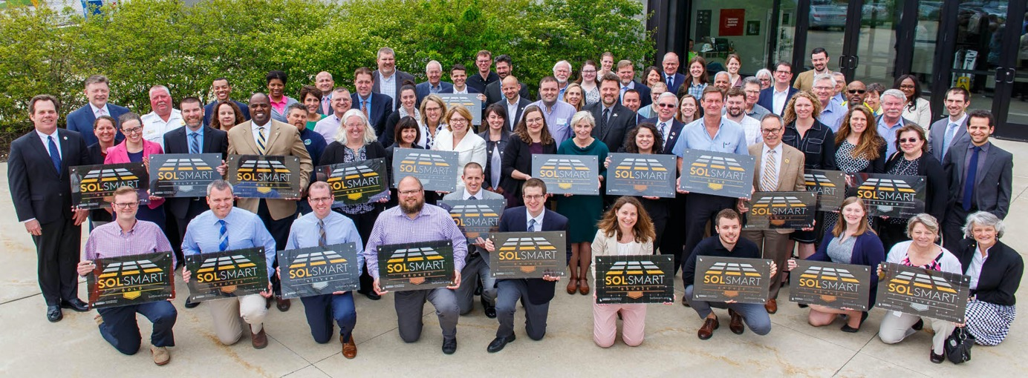
SolSmart Success
  Streamline solar codes
  Extensive checklist & point system
  Work collaboratively
  5800% in rooftop solar in Schaumburg
Illinois #1

Slide 3
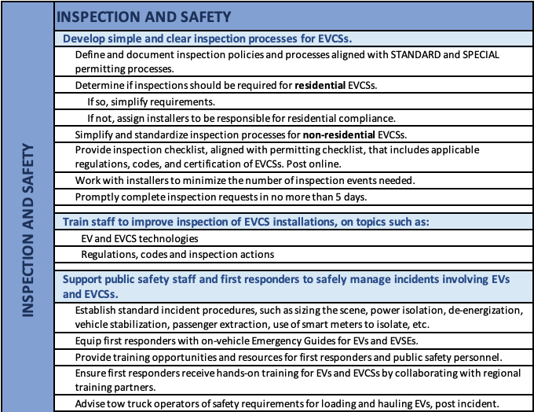
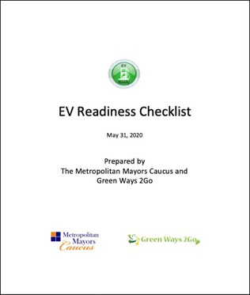
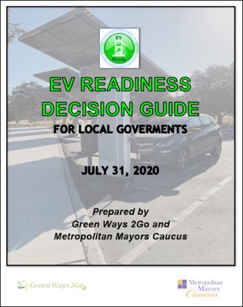

Becoming EV Ready Project
Listening Sessions
Checklist
Decision Guide
  THANK YOU TO THE JOYCE FOUNDATION!
Checklist and guide available at:
mayorscaucus.org/initiatives/environment/becoming-ev-ready/

Slide 4

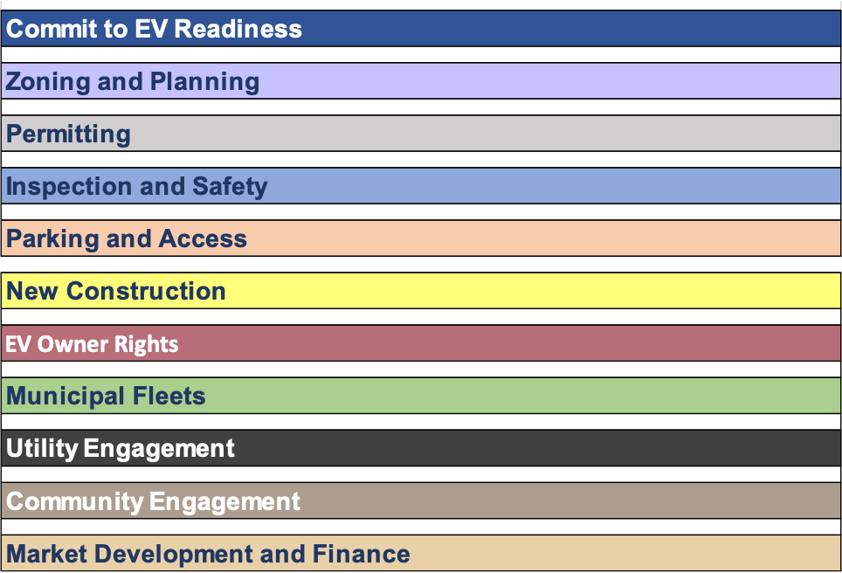
Future EV Ready program
Support for checklist action items
Collaboration and Facilitation
Recognition
Regional planning

Slide 5

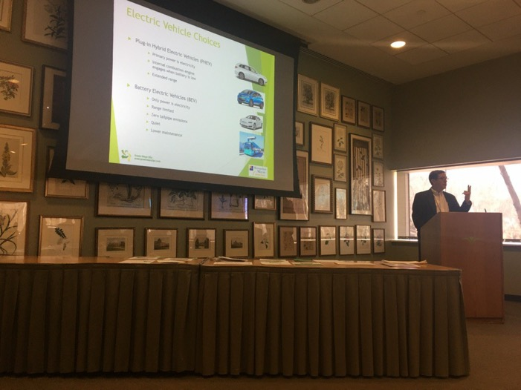
Listening Sessions
Municipalities
  Elected Officials
  Planners
  Building code officials
  Fire safety
EV Industry
  EV dealers
  Electrical contractors
  Charging station vendors
ComEd
Downtown business association
Environmental advocates, such as Go Green Illinois
The EV Ready Team held a listening session in early March at the Go Green Illinois meeting.

Slide 6

EV Readiness Checklist
Full checklist at: mayorscaucus.org/initiatives/environment/becoming-ev-ready/

Slide 7
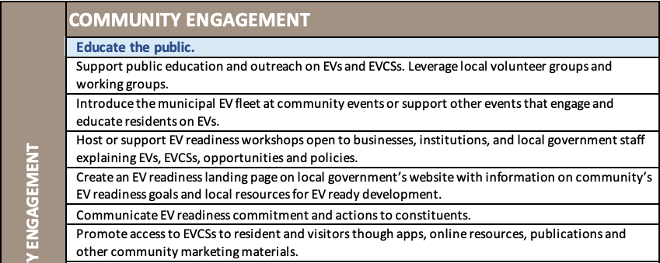
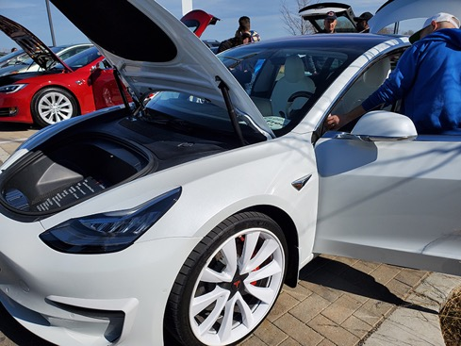
EV Ready Checklist: Example
Going Green Matters EV exhibit in March 2020

Slide 8
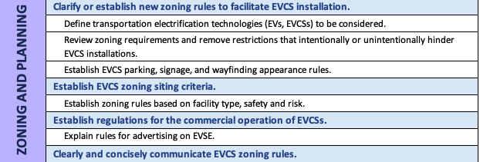
EV Ready Checklist: Example

Slide 9
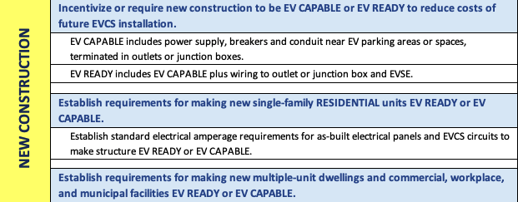
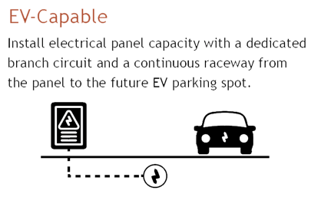
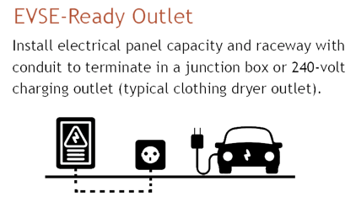
EV Ready Checklist: Example
Graphic source: Southwest Energy Efficiency Project

Slide 10
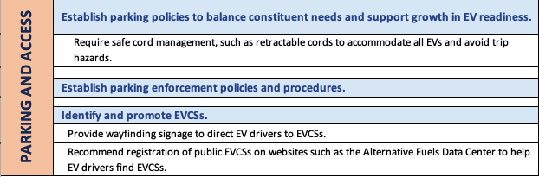

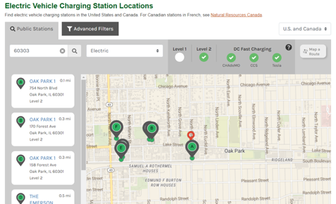
EV Ready Checklist: Example

Slide 11
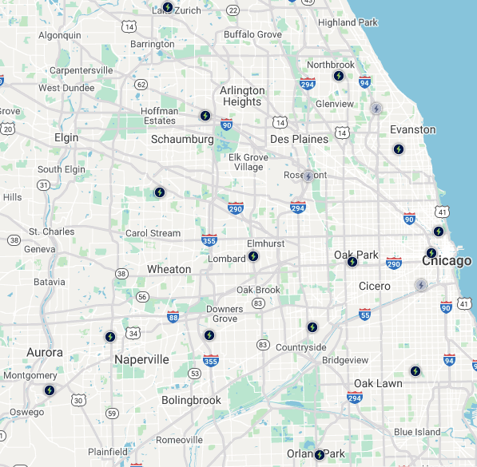
EV Charging Station Locations
AFDC Public Charging Station Map – most EVSE brands
  https://afdc.energy.gov/stations#/find/nearest
ChargePoint Station Locator
  https://na.chargepoint.com/charge_point
PlugShare (most brands)
  https://www.plugshare.com/
Google Maps (most brands) - Enter “EV charger near me”
  https://www.google.com/maps/
Electrify America Station Locator
  https://www.electrifyamerica.com/locate-charger
Tesla Supercharger Station Locator
  www.tesla.com/findus
Above: Tesla chargers, right: Electrify America existing/planned chargers

Slide 12
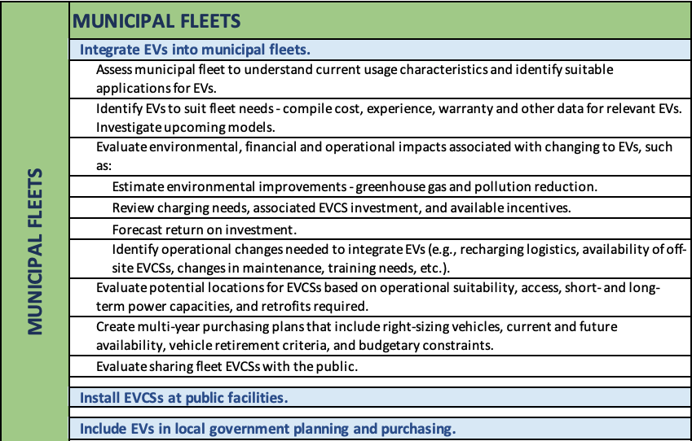
EV Ready Checklist: Example

Slide 13
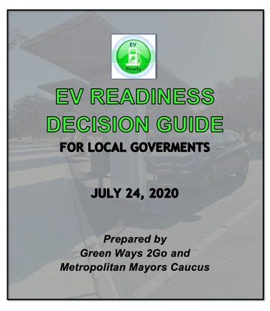
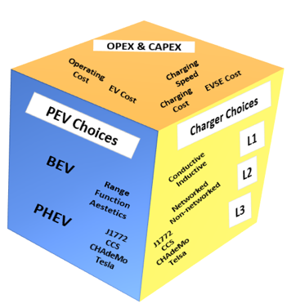
EV Readiness Decision Guide: Support Local Governments
Making purchase decisions – EVs, EV Charging
Planning / deploying EV Charging Projects
Measuring Success
  Sustainability and fleet operation impacts and business cases
Policies and incentives
Parking considerations
Connecting Regionally
Utility and the grid
Electrifying Public Fleets
Looking Forward
Available at:
https://mayorscaucus.org/initiatives/environment/becoming-ev-ready/

Slide 14
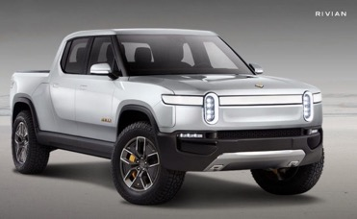

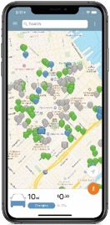
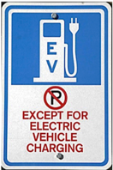
EV Readiness Decision Guide
EV and EV Charging Choices, options and features explained plus useful links
  ABCs of EVs
  Types, availability and timing of EVs
  Types of EV Chargers
  EV batteries & range
  EV charging best practice
  Charging levels
  Costs, ROIs and project justifications
  Charging at public, workplace, Multiple Unit Dwelling sites
  Finding chargers
  Selecting EV Charger sites

Slide 15


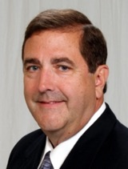

Questions? And thank you!
Metropolitan Mayors Caucus
Edith Makra
emakra@mayorscaucus.org
Cheryl Scott
cscott@mayorscaucus.org
Green Ways 2Go
Tim Milburn
847-826-3314
tim.milburn@greenways2go.com
Full checklist at: mayorscaucus.org/initiatives/environment/becoming-ev-ready/

