Slide 1
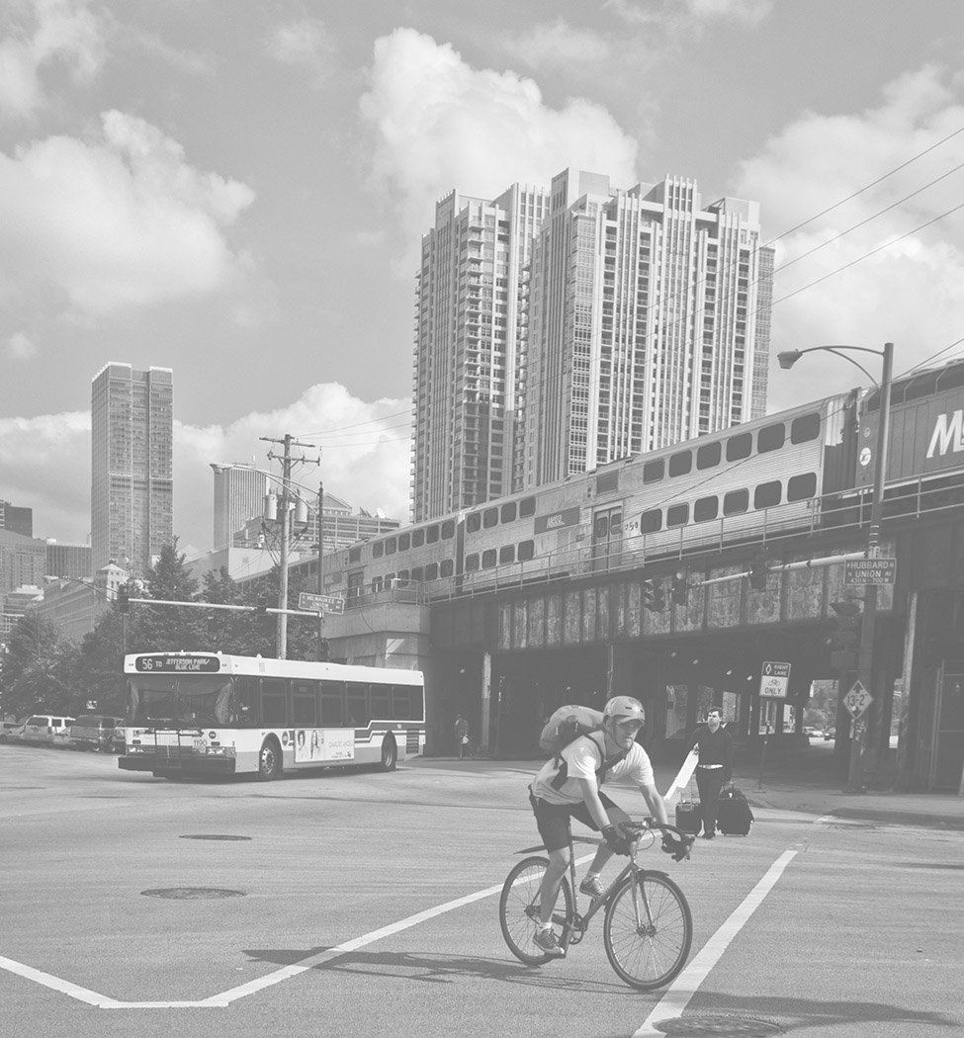
Multimodal Transportation in Chicagoland
March 10, 2020
Maggie Melin
Active Transportation Alliance

Slide 2
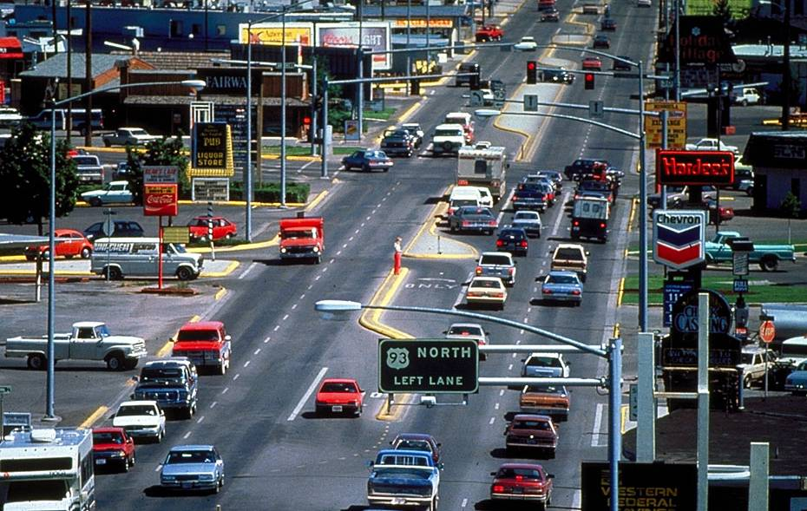
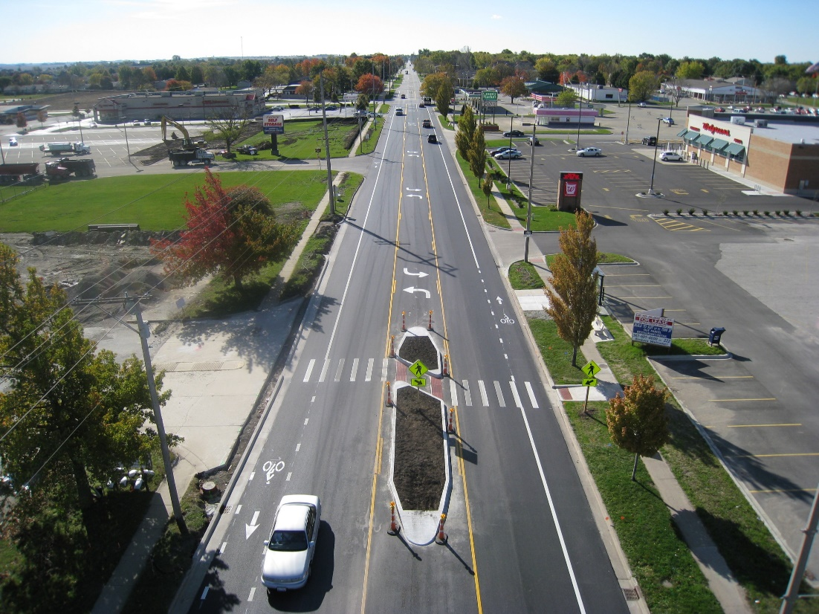
Agenda
Mode share in Chicagoland
Policies & plans
Funding opportunity
Route 53 Extension
Getting involved

Slide 3
Regional Mode Share

Slide 6
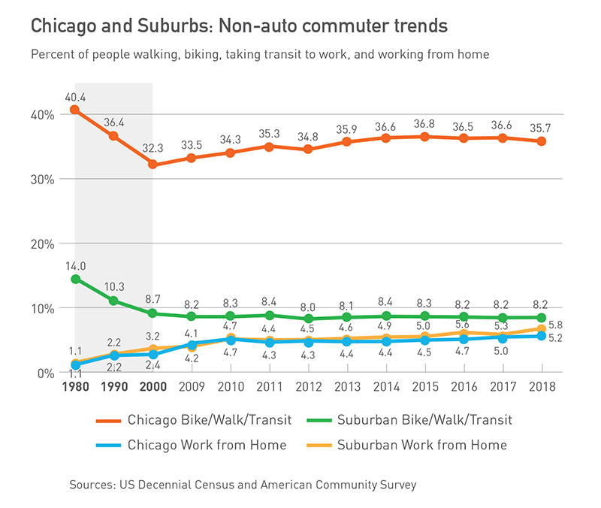

Slide 7
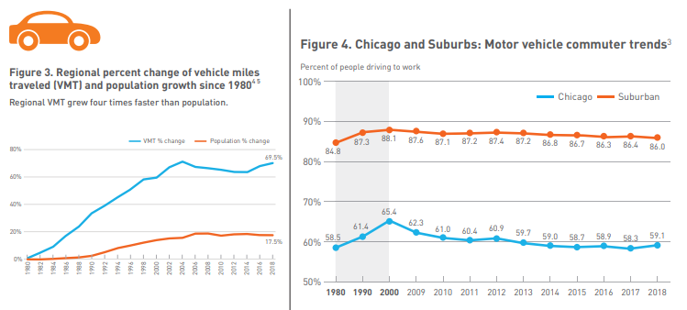

Slide 8
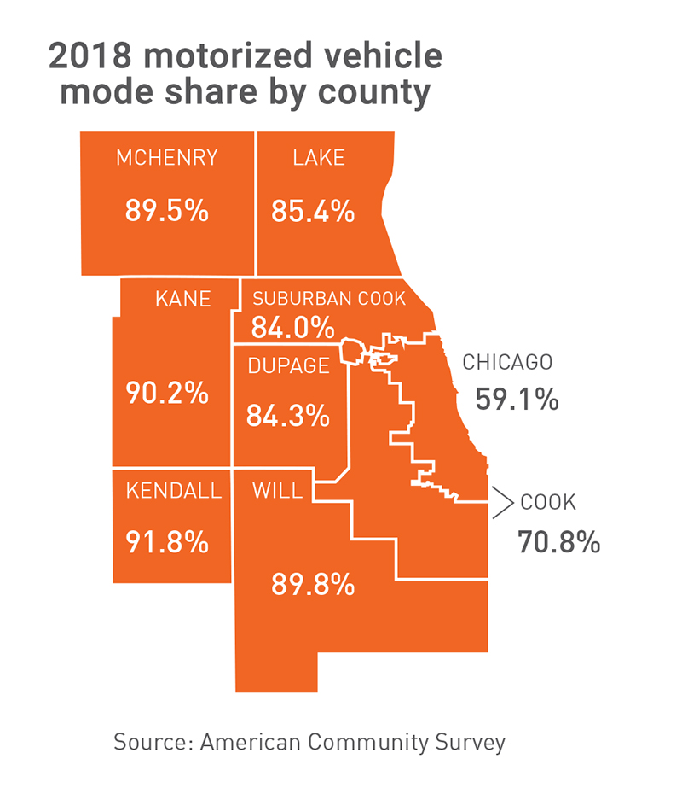
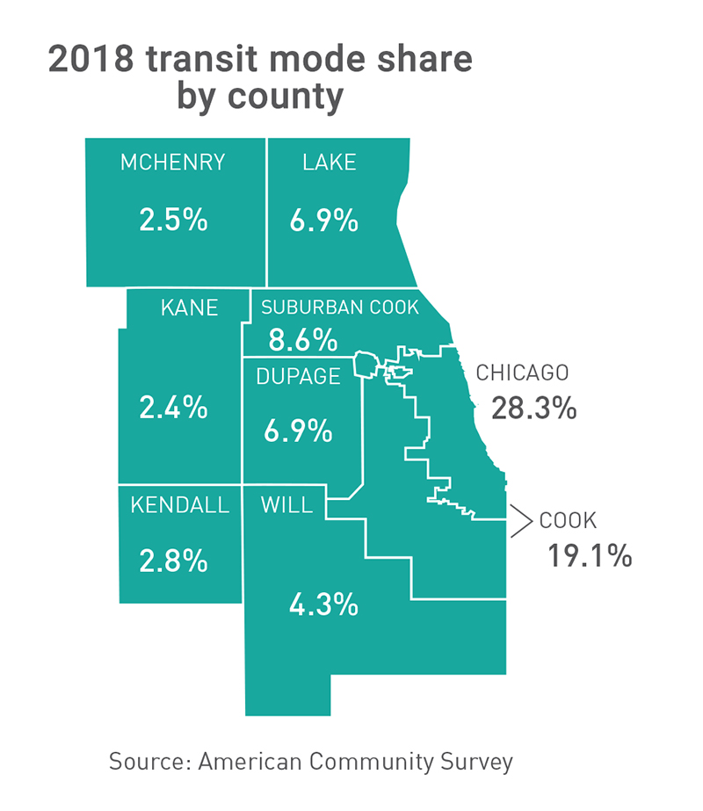

Slide 9
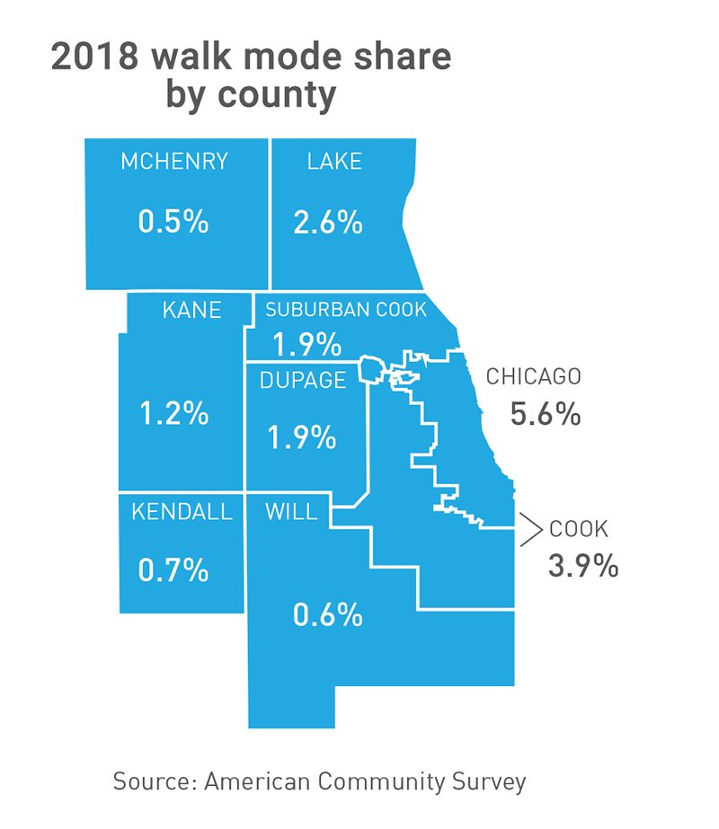
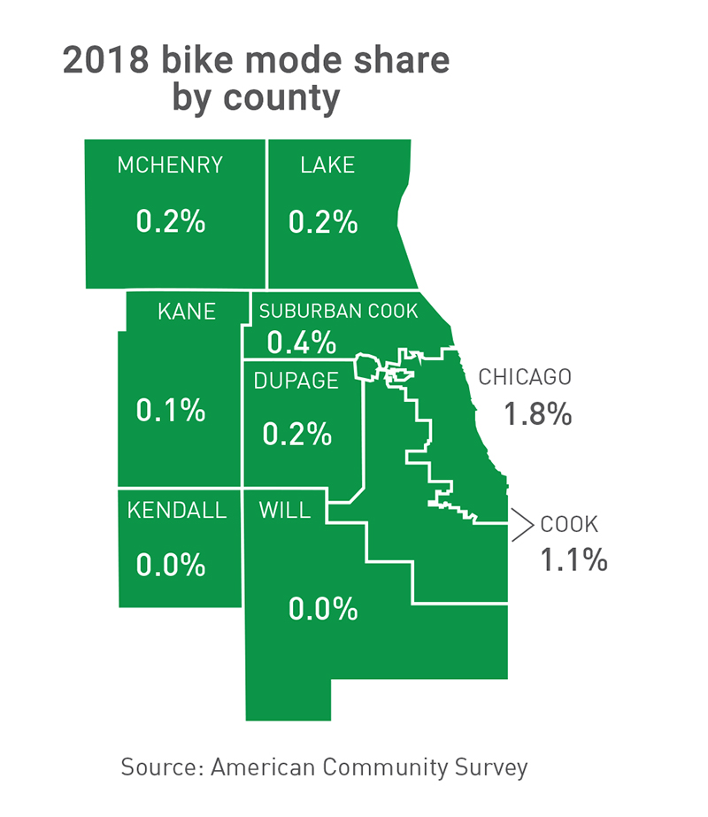

Slide 10
Suburban Plans & Policies

Slide 11
Complete Streets can be safely crossed and traveled upon and alongside by all users of the roadway, regardless of their age, ability or travel mode.

Slide 12
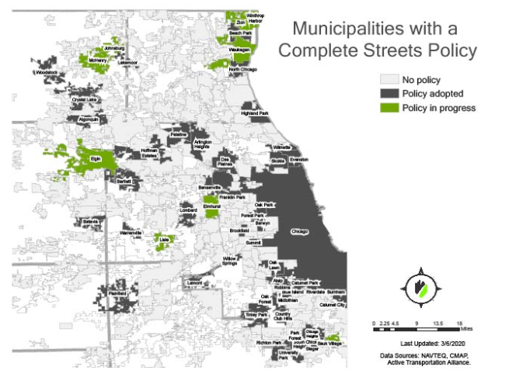
More than 1,500 nationally
At least 45 in Chicagoland
Resolutions, ordinances, plans, executive orders

Slide 13
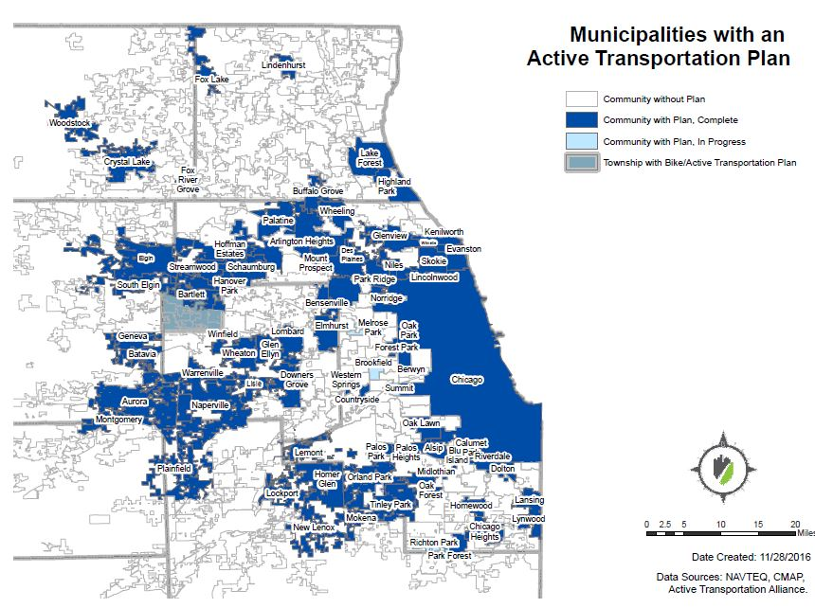
Municipalities with Active Transportation Plans
At least 74 plans in Chicagoland
Recommend updating every 5 to 10 years

Slide 14
Funding Opportunity

Slide 15
2019 Goal
Establish $50 million in dedicated state funding for walking, biking, and trail projects in the capital bill
Notes:
This resource was designed as an guide to provide municipalities with effective strategies for working with IDOT to integrate a Complete Streets approach into roadway projects.
The guide explains the key parts of Illinois’ Complete Streets policy, the IDOT project process, and strategies for working with IDOT to on IDOT-led and locally-led projects. It’s 44 pages, but this presentation distills that down to its most important takeaways.
We’ll also share a few stories of how communities have worked with the agency to build the facilities that they want to see.
Tim is discuss advice for getting walking/biking included in projects + other advice
Ed to discuss IDOT responses to facility requests

Slide 16
Why?
Approval Status | Location | Funding Cycle | Project Title
Approved | Northbrook | 2018-22 | Skokie Valley Trail Extension
Approved | Skokie | 2018-22 | Village of Skokie - Skokie Valley Trail
Approved | Glenview | 2017-18 | Chestnut Avenue muti-use path
Denied | Glenview | 2018-22 | Village of Glenview Willow Road Multi-Use Path
Denied | Mount Prospect | 2017-18 | Bicycle/ Ped Bridge over Northwest HW and UPRR
Denied | Glenview | 2017-18 | Glenview - Willow Road Multi-Use Path
Denied | Kenilworth | 2017-18 | Kenilworth- Green Bay Trail Realignment
Denied | Lake Forest | 2017-18 | Route 60 Bicycle Path Connectivity Project
Denied | Winnetka | 2017-18 | Metra - Hubbard Woods Station Bike, Ped, ADA Bridge and Access Improvements
Denied | Lake Forest | 2017-18 | Robert McClory Bike Path Ped Bridge Replacement
Denied | Highland Park | 2017-18 | Sheridan Road Non-Motorized Improvements
Denied | Highland Park | 2017-18 | St. Johns Bike Path Relocation
Denied | Lincolnshire | 2017-18 | Stage 3 Streetscape
Denied | Des Plaines | 2017-18 | U.S. Route 12 (Rand Road) Sidepath
Denied | Wilmette | 2017-18 | Wilmette - East Lake Avenue Bike Bridge
Denied | Prospect Heights | 2017-18 | Wolf Road Sidewalk Connectivity Project â€“ Phase III
Denied | Glenview | 2016-20 | Chestnut Av Multi-Use Path
Denied | Highland Park | 2016-20 | Clavey Rd from Barberry Rd to Skokie Valley Bike Path
Denied | Lake Forest | 2016-20 | Middlefork Savanna Forest Preserve Trail
Denied | Glenview | 2016-20 | Milwaukee and Lake Av Multi-use Path
Denied | Wheeling | 2016-20 | Milwaukee Ave at Hintz Rd Sidewalks
Denied | Skokie | 2016-20 | Old Orchard Rd from Harms Rd to Woods Dr
Denied | Highland Park | 2016-20 | Walker Av from St. Johns Av to Oak St
Denied | Glenview | 2015-16 | Chestnut Avenue Multi-Use Path
Denied | Northbrook | 2015-16 | Cook and Lake Counties - Skokie Valley Trail Bridge
Denied | Highland Park | 2015-16 | Crosswalk Safety Enhancements
Denied | Highland Park | 2015-16 | St. Johns Bike Path Relocation
Denied | North Chicago | 2015-16 | Lake County DOT - 14th Street Improvement
Denied | Lake Forest | 2015-16 | Route 60 Bicycle Path Connectivity Project
Denied | Lake Forest | 2015-16 | Telegraph Road Train Station Pedestrian Underpass
Denied | Northbrook | 2015-16 | Metra Train Station Bike Parking and Bike Shelter
Denied | Northbrook | 2015-16 | Northbrook - Skokie Valley Trail Extension
Denied | Northbrook | 2015-16 | Northbrook - Skokie Valley Trail Extension
Denied | Des Plaines | 2015-16 | Oakton Street Sidepath
Denied | Highland Park | 2015-16 | Rehabilitation of the Pedestrian Overpass Over Rt. 41 South of the Deerfield Rd./Central Av. Interchange
Denied | Skokie | 2015-16 | Skokie - Skokie Valley Trail Extension
Denied | Northfield | 2015-16 | Skokie Valley Trail, northern-most border of Northfield to Old Orchard Road
High Demand: Applications for Illinois Transportation Enhancement Program (ITEP) funds have exceeded available dollars by a factor of 7.
Notes:
Funding - Funding, staff, and other resources in a community should be fairly allocated to bike/ped projects.
Include line item in transportation budget.
In 2016 Skokie allotted $20,000 per year in its 5-year Capital Improvement Plan for Complete Streets improvements.
Additional support for low and moderate resource communities should be provided by regional, state, and federal governments.

Slide 17
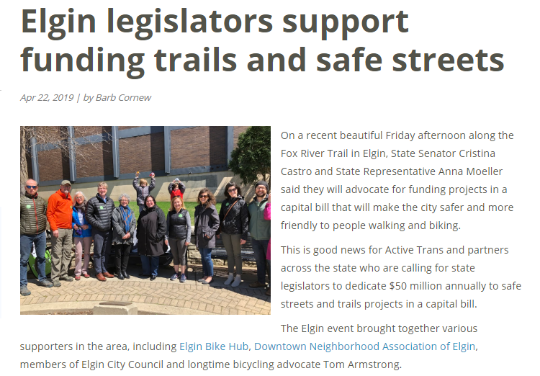
How?
Developed relationships with state legislators – found champions.
Hired lobbyist in Springfield
Local Advocacy: Supporters made 3,400+ connections via emails, tweets, calls, witness slips.
Notes:
Funding - Funding, staff, and other resources in a community should be fairly allocated to bike/ped projects.
Include line item in transportation budget.
In 2016 Skokie allotted $20,000 per year in its 5-year Capital Improvement Plan for Complete Streets improvements.
Additional support for low and moderate resource communities should be provided by regional, state, and federal governments.

Slide 18
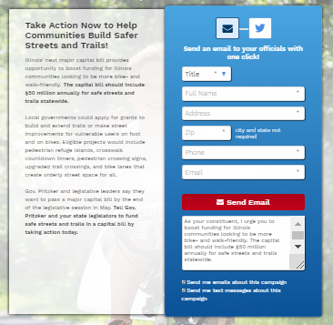
3 ways to take action
Email your state senator and representative
Call your elected official’s office
Meet in-person with your senator or representative
Send a pre-written letter via activetrans.org/takeaction
Notes:
This resource was designed as an guide to provide municipalities with effective strategies for working with IDOT to integrate a Complete Streets approach into roadway projects.
The guide explains the key parts of Illinois’ Complete Streets policy, the IDOT project process, and strategies for working with IDOT to on IDOT-led and locally-led projects. It’s 44 pages, but this presentation distills that down to its most important takeaways.
We’ll also share a few stories of how communities have worked with the agency to build the facilities that they want to see.
Tim is discuss advice for getting walking/biking included in projects + other advice
Ed to discuss IDOT responses to facility requests

Slide 19
Victory! $50 million for Walking and Biking

Slide 20
Advocacy Outcome
$50 million annually** (in addition to federal dollars) provided through Illinois Transportation Enhancement Program (ITEP), administered by IDOT.
Prioritizes funds for high-need communities
Sliding scale local match for low-income communities
Sets aside at least 25% of funds for high-need communities.
Notes:
Funding - Funding, staff, and other resources in a community should be fairly allocated to bike/ped projects.
Include line item in transportation budget.
In 2016 Skokie allotted $20,000 per year in its 5-year Capital Improvement Plan for Complete Streets improvements.
Additional support for low and moderate resource communities should be provided by regional, state, and federal governments.

Slide 21
What’s next?
IDOT currently working out funding guidelines
funding cycle, how to apply, equity component, etc.
Meeting regularly with IDOT
Funding should be available in fall of 2020
Webinars planned
Notes:
Funding - Funding, staff, and other resources in a community should be fairly allocated to bike/ped projects.
Include line item in transportation budget.
In 2016 Skokie allotted $20,000 per year in its 5-year Capital Improvement Plan for Complete Streets improvements.
Additional support for low and moderate resource communities should be provided by regional, state, and federal governments.

Slide 22
Route 53 Corridor

Slide 23
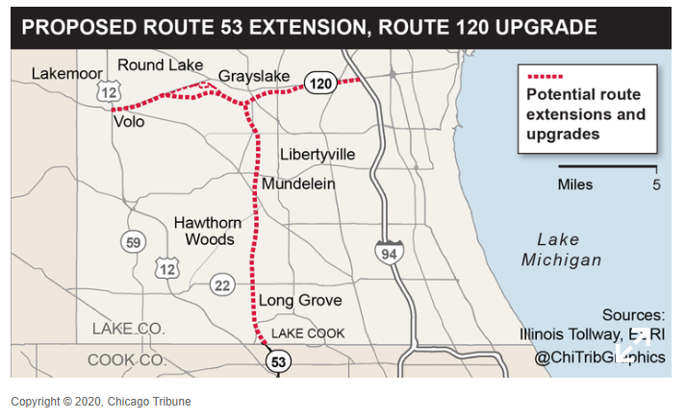
Route 53 Extension - $3 Billion Project

Slide 24
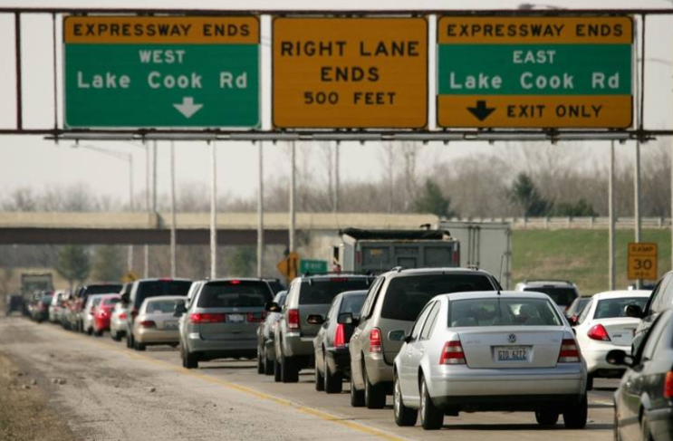
Route 53 Extension Timeline
1960’s –Extension first considered
2017 - $25M environmental impact study (EIS) planned
July 2019 – Lake County Board removes extension from strategic plan
July 2019 – IL Tollway drops EIS
Notes:
Funding - Funding, staff, and other resources in a community should be fairly allocated to bike/ped projects.
Include line item in transportation budget.
In 2016 Skokie allotted $20,000 per year in its 5-year Capital Improvement Plan for Complete Streets improvements.
Additional support for low and moderate resource communities should be provided by regional, state, and federal governments.

Slide 25
Route 53 Extension Advocacy
Sierra Club Illinois
Midwest Sustainability Group
Livable Lake County
Environmental Law and Policy Center
Openlands
Notes:
Funding - Funding, staff, and other resources in a community should be fairly allocated to bike/ped projects.
Include line item in transportation budget.
In 2016 Skokie allotted $20,000 per year in its 5-year Capital Improvement Plan for Complete Streets improvements.
Additional support for low and moderate resource communities should be provided by regional, state, and federal governments.

Slide 26
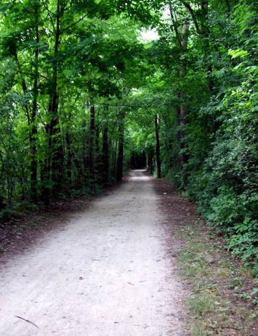
Route 53 Extension Advocacy
Gathering support in Springfield for Senate Joint Resolution (SJR 52)
Create Route 53 Alternative Use Task Force to “study the cost, feasibility and environmental impact of alternative uses of the expansion land.”
State Senate Sponsors
Dan McConchie
Melinda Bush
Julie A. Morrison
Notes:
Funding - Funding, staff, and other resources in a community should be fairly allocated to bike/ped projects.
Include line item in transportation budget.
In 2016 Skokie allotted $20,000 per year in its 5-year Capital Improvement Plan for Complete Streets improvements.
Additional support for low and moderate resource communities should be provided by regional, state, and federal governments.

Slide 27
Getting Involved

Slide 28
Mobilizing in your community
Create a campaign to advocate for better walking and biking in your own community.
Trainings:
April 25 – Suburban Walk, Bike, Trail Summit
Webinars – Funding, Zoning, Elected Official Engagement
Mini-stipend opportunities:
Suburbs: Bike Walk Every Town mini-stipends

Slide 29
Take Action
Attend a training and future webinars
Create a campaign for your neighborhood or community
Prepare to mobilize for upcoming state policy priorities (share, email, call, meet and repeat)
Sign up for your local elected official’s newsletter
Join our suburban email listserv
Notes:
Maggie

Slide 30
Stay up to date
Activetrans.org/blog
Activetrans.org/advocacysignup
Activetrans.org/takeaction
Twitter: @activetrans
Facebook: facebook.com/activetrans
Instagram: @activetrans
YouTube: The Active Transportation Alliance

Slide 31
Thank You!
Maggie Melin
Advocacy Manager
Maggie@activetrans.org

