Slide 1

Go Green Illinois
May 11, 2021
James Jennings, Illinois EPA

Slide 2
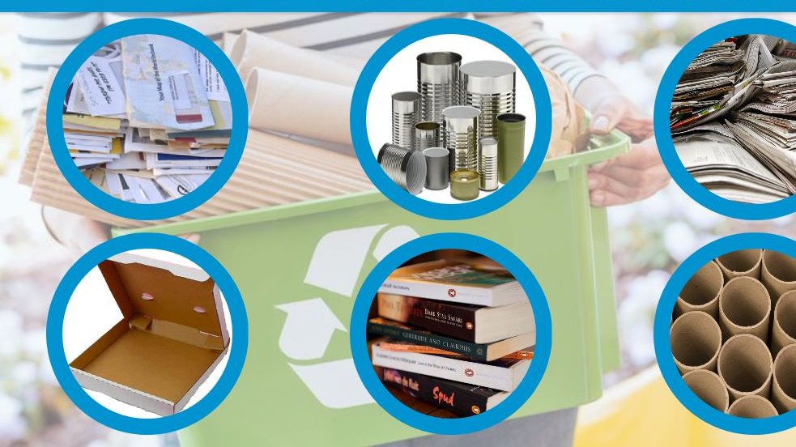
Our Operational Commitment
Support local collection events, with a focus on environmental justice impacts
Produce educational content to encourage use of diversion options recognizing the diversity of this state
Prepare foundation to financially support education, infrastructure, and market development opportunities in Illinois
Partner with stakeholders to continue to advance diversion options for all Illinois residents

Slide 3

On COVID-19
Curbside collections narrowed
New recycling contaminants
Organics hauling limited
Collection sites shuttered

Slide 4
Materials Management Advisory Committee Objectives
Statewide waste composition estimate
Diversion market analysis
Materials to target for diversion
Education and outreach to maximize diversion
Diversion goals
Map of permitted facilities
Standardized content for county waste management plans

Slide 5
Recommendations Adopted
$2 million in additional annual appropriations for materials management projects:
  $1 million for market development grants
  $1 million for statewide education and outreach
Creation of a Statewide Market Development Advisory Board
Development of a statewide waste reduction marketing campaign
Statewide data gathering enhancements
  Annual MRF and compost facility accepted materials survey
  Map of entities that reuse or repurpose difficult to divert materials
  State recycled content purchasing tracking

Slide 6
Pending Recommendations
Statewide diversion targets of:
  40 percent by 2025
  45 percent by 2030
  50 percent by 2035
Stratified approach to targeting materials for diversion
At least $1 million in annual appropriations for infrastructure grants for:
  Recycling facilities
  Compost facilities
  Additional HHW collections
Statewide data gathering enhancements
    Procurement of statewide data tracking services
    Maintain asset map of permitted sites, MRFs, compost facilities,
    Periodic statewide waste characterization study
    Flexibility for county solid waste reporting

Slide 7

Organics Plan Objectives
Reduce wasted food in Illinois by 50 percent by 2030
Connect food waste generators with sustainable non-disposal outlets
Encourage expansion of existing food diversion programs and composting operations
Ease regulatory barriers to entering the composting and diversion marketplace

Slide 8

Thank you!
James Jennings
217-524-1852
James.m.Jennings@Illinois.gov

